Slide 2
PLACE Fieldwork
Level 1: Community informant interviews
Level 2: Venue informant interviews and mapping
Level 3: Patron and worker interviews and HIV testing
Notes:
There are three levels of PLACE fieldwork. We will start with the first level, the community informants.

Slide 3
Purpose of community informant interviews
Collect names, locations, and information about venues where people meet new sex partners or inject drugs.
  Public places for socializing: bars, restaurants, discos
  Other public places: markets, beaches, parks, streets, taxi stops
  Events: community festivals
  Websites, social media applications, telephone numbers
Notes:
READ SLIDE
Keep in mind that you will be using the information you collect about venues and their locations to later visit these places. The clearer the information is about locations, the easier your job will be in the next phase of fieldwork.
We use the word “venue,” but we are really referring to any type of place or means by which people meet sex partners.

Slide 4
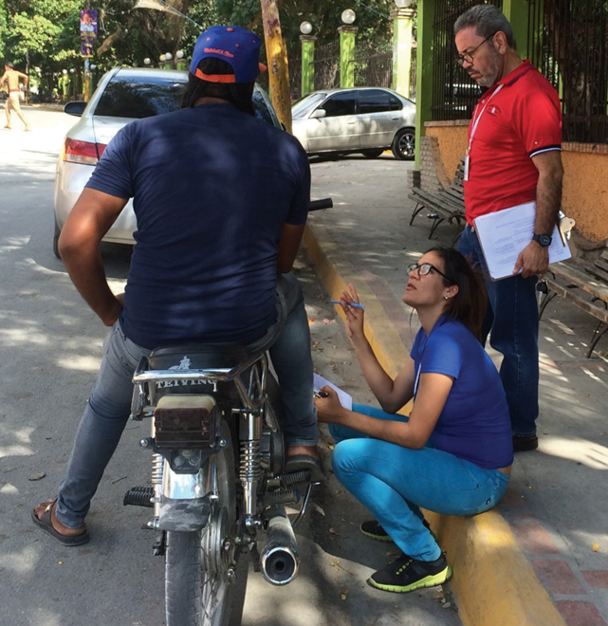
How do we get this information?
Talk to people in the community

Slide 5
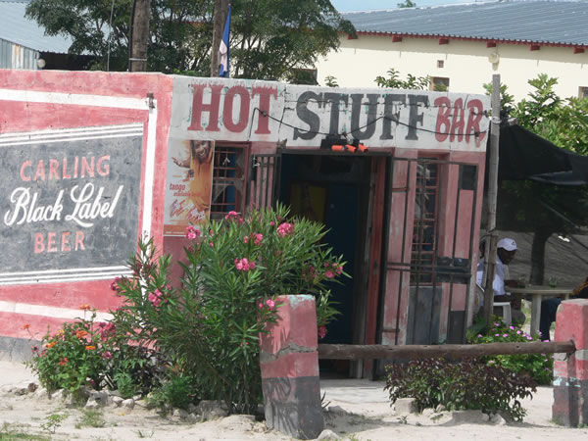
Who are community informants?
People who are likely to know what happens in the community, especially about where people go to meet sex partners or inject drugs

Slide 6
Who are community informants?
  Taxi driver
  Truck driver
  Bar owner or worker
  Person socializing at a bar
  Security guard/car guard
  Transgender person
  Person who injects drugs
  Man who has sex with men
  Woman who exchanges sex for money
  Hairdresser
  Community leader
  Youth in school
  Youth out of school
  Military/police
  Staff of a community-based or nongovernmental organization
  Peer educator
  Community health worker
  Trader/business person
  Hawker/street vendor
  Unemployed/person loitering

Slide 7
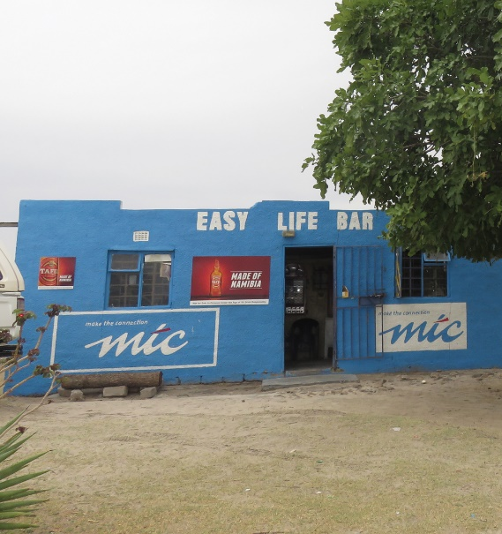
Key populations as community informants
Key populations are at greater risk for HIV.
Venues visited by these populations are important for prevention efforts.
Key population members themselves will know these venues best.
Sometimes these types of informants are difficult to find during the day.

Slide 8
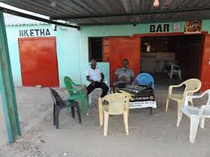
Knowledge, not occupation
Select community informants because of what they are likely to know, not because of their job or occupation.
For example, a man at a bar is approached to be a community informant. It is not necessary to ask his occupation because he is approached as a bar patron.
Notes:
Sometimes people confuse the type of community informant with the job he or she has. When an informant’s job is what makes them knowledgeable, then occupation and type of informant are the same, as in the case of a bar owner. However, other times, this is not the case. For example, a person socializing at a venue may be able to name venues, and his or her occupation is not important.

Slide 9
Targeted community informant types
For each type of informant, there is a target number. This ensures that a variety of venues are named.
The Fieldwork Supervisor will assign target numbers of community informant types to each interviewer. The targets will appear on the Interviewer Target and Tally Sheet that you will be given to document your work.
Notes:
Not all types of informants will be sought in every area.
Note: “FORM 1-1. INTERVIEWER TARGET AND TALLY SHEET FOR COMMUNITY INFORMANT INTERVIEWS” can be found in Step 2.12 of the Fieldwork Implementation Guide, in the PLACE Tool Kit available here: https://www.measureevaluation.org/resources/tools/hiv-aids/place.

Slide 10
Tally Sheet
Interviewer Target and Tally Sheet for Community Informant Interviews
Notes:
Note: Give one tally sheet (Step 2.12 of the Fieldwork Implementation Guide) and one PLACE Form A and one Form A Fact Sheet for Informed Consent by a Community Informant (both in Step 2.8 of the guide) to each interviewer. These materials are also available as discrete files in the PLACE Tool Kit, online.

Slide 11
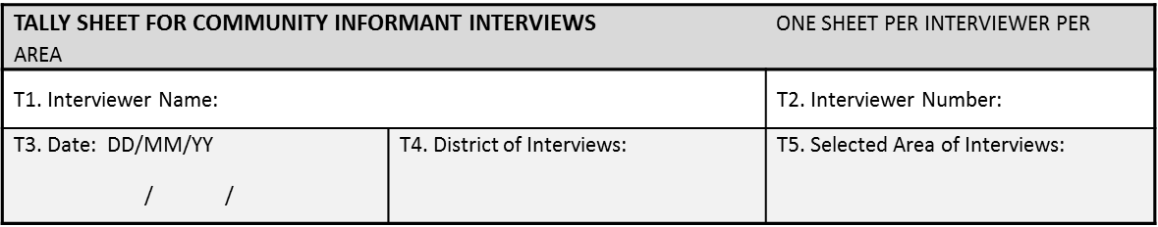
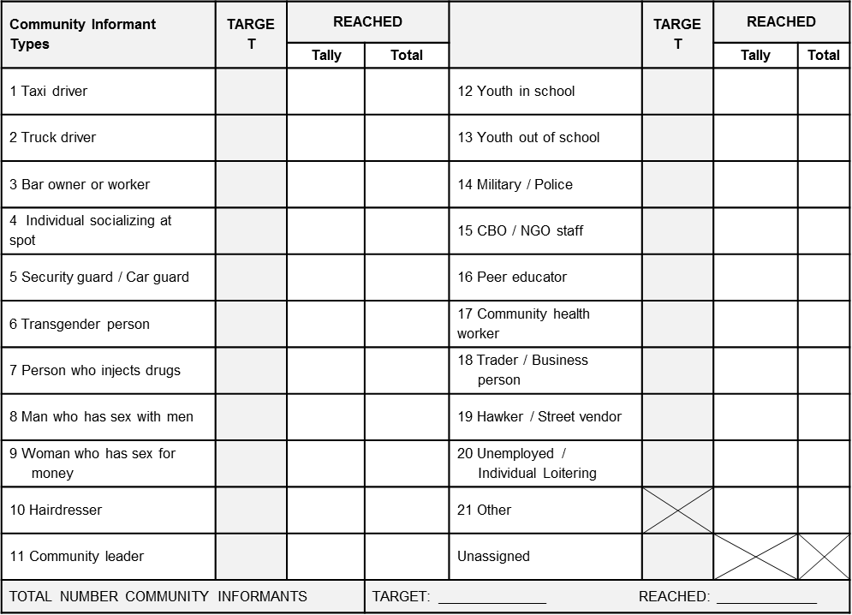
Blank Tally Sheet
Notes:
Note: Modify slide to show a picture of the tally sheet as adapted for this study.
The tally sheet is used to indicate the targeted types of informants and to record the types interviewed. You will notice the types of informants identified to be knowledgeable about where people meet new sex partners. Some types were identified because they move people around and know where they are going, such as taxi drivers. People associated with venues, such as a bar owner or employee or someone having a beer, are already knowledgeable about one venue and so may know where else people go. Some people are at higher risk for HIV, such as the key populations listed here. We want to know from them where other members of their population go. We want to interview people of different ages and different socioeconomic status to make sure we are getting a complete list of venues, so you will see youth in school and youth out of school, but also business person, street vendor, and even people who stay in one place all day but observe what occurs in the community. People who work in healthcare or nongovernmental organizations may also have good information. And military personnel will know where men away from their families go, and police will know about the nightlife in a community.
This is how you use this form:
The supervisor will fill in the District, Selected Area, and the Target column.
Each interviewer will fill in his or her name, ID number, and the date of data collection.
If the Fieldwork Supervisor wants specific interviewers to have a certain targeted type of informant, the supervisor may fill in the interviewer name and ID number.
During fieldwork, the interviewer will use the tally column to mark the types of informants interviewed, one mark for each. At the end of the day, the interviewer will add up the tally marks and enter the number in the “Total” column.

Slide 12
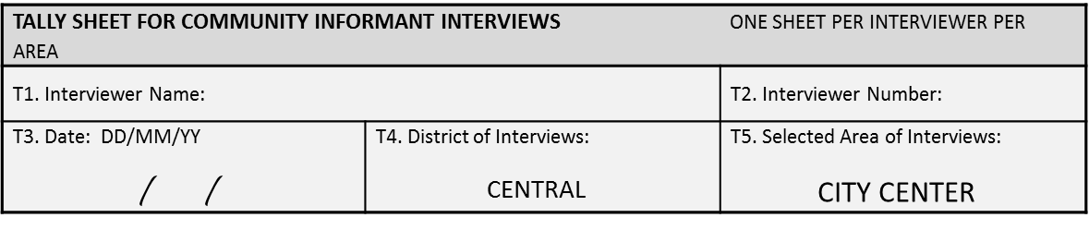

Supervisor filled in prior to fieldwork
Notes:
Note: Modify slide to show a picture of the tally sheet as adapted for this study.
Here is an example of a tally sheet filled in by the supervisor prior to fieldwork. These community informant interviews will take place in Central District in the selected area we are calling City Center.
This interviewer is assigned a target of 10 informants: four taxi drivers, one bar owner or worker, one security guard, one woman exchanging sex for money/female sex worker, and two military personnel or policemen.
There is one type of informant that is marked “unassigned.” This means that the interviewer should look for another type of informant to interview. This respondent may be from the types that have no target listed, such as a truck driver, a community leader, or a young person out of school. If the interviewer finds another informant who knows what occurs in the community but no type of informant listed describes that person, the interviewer marks “other.” An example is a liquor store owner.

Slide 13
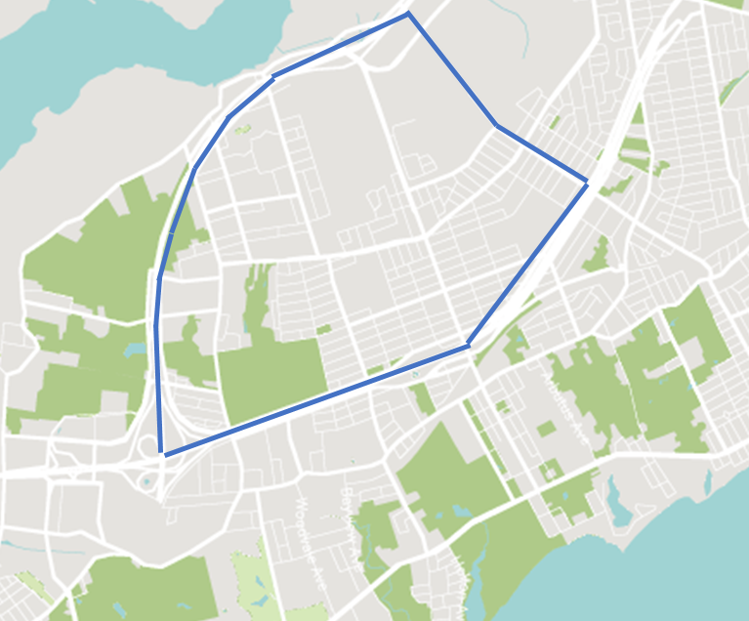
Boundaries of selected area
City Center is the name of the selected area.
Interviewers must know the boundaries.
Look for informants within those boundaries.
Focus on identifying venues within those boundaries.
Notes:
Because we can’t cover the entire country, the National Steering Committee has selected specific areas to be covered. It selected areas in districts that can be referred to as subdistricts.
The sample Tally Sheet says the selected area is called City Center. Continuing with this example, note that the interviewers should be aware of the boundaries. Different people might not agree on what the boundaries of City Center are. For the purposes of PLACE, the boundaries of City Center have been established and the interviewers should keep them in mind during fieldwork.
Focus on finding informants within the boundaries. Ask the community informants to name venues within those boundaries. They may name venues outside the boundaries and it is ok to find out information about them, but remember that the focus is City Center.
If you do not know the boundaries of a selected area for fieldwork, ask the Fieldwork Supervisor.

Slide 14
Priority prevention areas
Some selected areas are referred to as priority prevention areas, or PPAs.
These areas were identified because of known activity that makes them a priority for HIV prevention efforts.
Some selected areas are not picked for PLACE because of known risk. Instead they are selected randomly.
Notes:
If all selected areas in this application of PLACE are PPAs, this slide can be deleted. The purpose of this slide is to explain why sometimes we refer to PPAs and why some selected areas are not PPAs.
In these slides and in the forms for PLACE, you will see the term “selected area.” Often a selected area is a PPA. PPAs are areas for conducting PLACE that were identified because of known activity making them a priority for HIV prevention programs. An example is a neighborhood known for female sex workers.
Some areas are picked randomly and are not known for any risky activity. They are not considered PPAs but are nevertheless areas selected for PLACE.

Slide 15
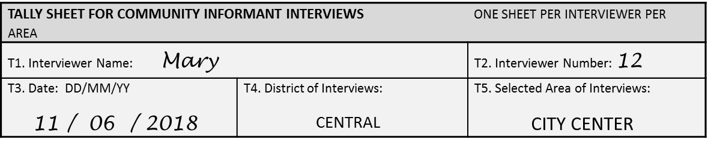

Interviewer filled in during fieldwork
Notes:
Here is the same form filled in by the interviewer named Mary, who has the ID number “12.” Fieldwork was done on June 11, 2018.
She had a target of four taxi drivers. She marked the “tally” column with a line each time she interviewed a taxi driver. At the end of the day, she totaled the tally marks and wrote “4” in the “total” column.
She met the targets for bar owner or worker, security guard, and military/police.
She was unable to find a female sex worker to interview. So, she made no tally marks and after fieldwork recorded “0” as the total.
However, she did interview 10 people. She found an individual at a venue, so marked a tally in that row. She also interviewed a street vendor.
The interviewer did NOT fill in the bottom portion in gray to indicate the total number of informants reached. The supervisor will count the total and will fill in this number.

Slide 16
Interviewer numbers
Each interviewer is assigned an identification number.
Use the same number throughout all phases of PLACE.
Notes:
Note: Give interviewers their numbers now. If the numbers fit on a slide, post them in this presentation and let the interviewers take note of theirs.

Slide 17
Fact Sheet
PLACE Form A:
Questionnaire for
Community Informants
Notes:
Note: Give one tally sheet, one Form A questionnaire, and one Form A Fact Sheet for Informed Consent by a Community Informant to each interviewer.

Slide 18
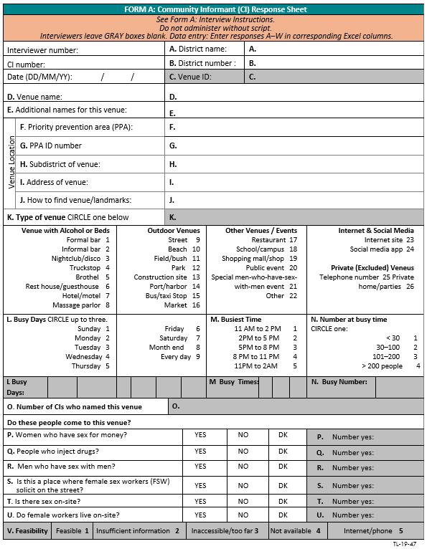
Blank Form A
Notes:
Note: Replace the image of Form A with the version that will be used in this application of PLACE.
Form A is also referred to as the community informant report because it is where the interviewer records the information about each venue the community informant reports.
Fill out one form for each venue. So, if an informant names nine venues, fill out nine Form As.

Slide 19
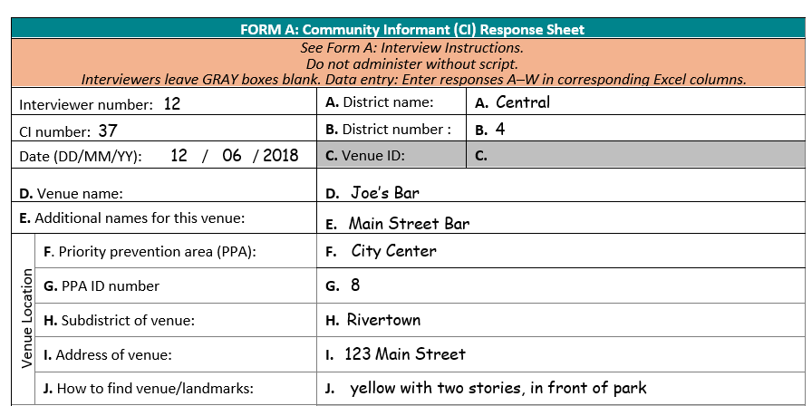
Top portion of Form A: Interviewer filled in
Notes:
Note: Replace the image of Form A with the version that will be used in this application of PLACE.
Note: Review each question in the form, using a brief description of what to fill in where. Later we will use the “Questions to Ask Community Informants” as the script to use with the form. Consider this a first look at the form in detail.
Note: Point out that the gray boxes are not filled in; this will not be done by the interviewers.
You will see that this portion of Form A focuses on the name of the venue and the location. Information about the location is very important because we will visit each venue in the next step. Be sure to get enough detailed information so that you can find the place without too much trouble.

Slide 20
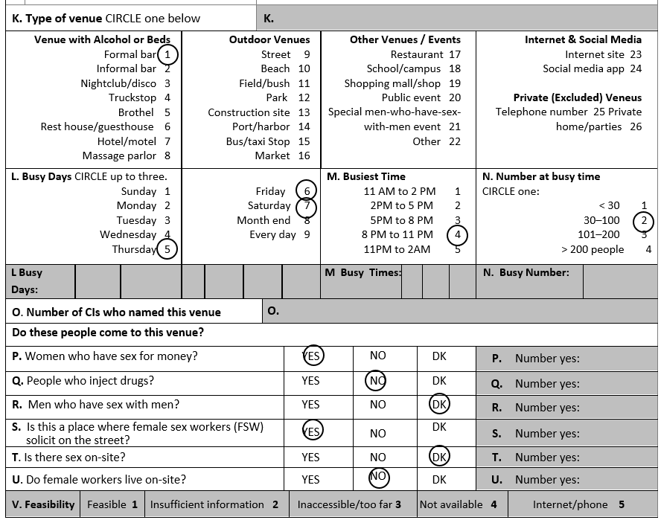
Bottom portion of Form A: Interviewer filled in
Notes:
Note: Replace the image of Form A with the version that will be used in this application of PLACE.
Note: Review each question in the form, using a brief description of what to fill in where. Later we will use the “Questions to Ask Community Informants” as the script to use with the form. Consider this a first look at the form in detail.
Note: Point out that the gray boxes are not filled in; this will not be done by the interviewers.

Slide 21
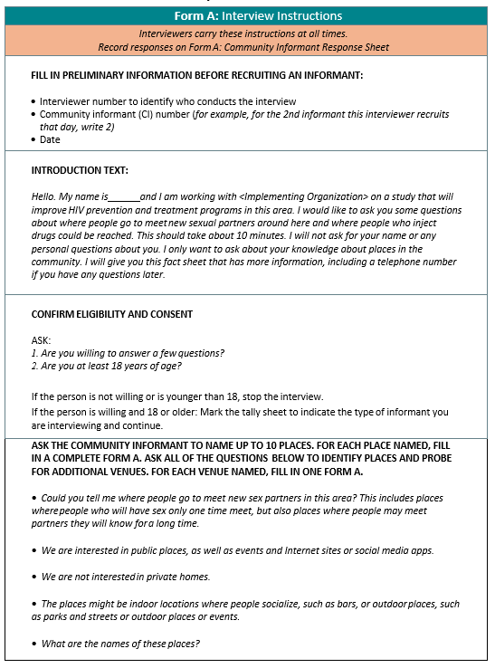
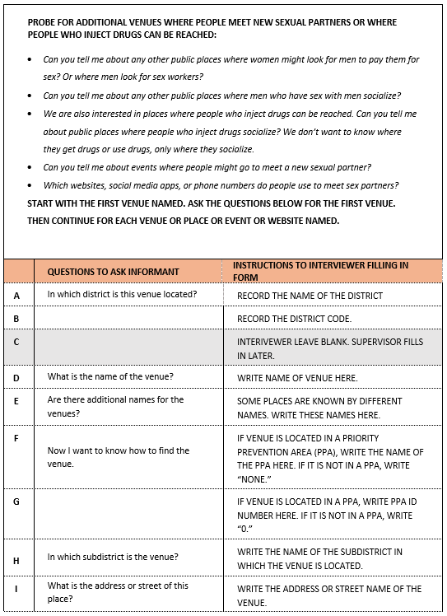
Questions to ask community informants
Notes:
Note: Replace the image of Questions to Ask Community Informants with the version that will be used in this application of PLACE. (The questions appear on PLACE Form A.)
You may have noticed that the Form A Response Sheet has space to record information about each venue, but does not include the text of each question.
Instead, the text of the questions is part of the Interview Instructions at the top of Form A, on the sheet called “Questions to Ask Community Informants.” You will carry one copy of this at all times. Interviewers use this by reading the question and then recording the information on the Form A Response Sheet. Think of this as the script of what you will say to community informants.

Slide 22

Activity: Read the questions
Read the questions to ask the community informants aloud.
Interviewers take turns reading a question.
After each question is read, the trainer describes the type of information sought and answers any questions.
Notes:
Note: The purpose of this activity is for interviewers to hear the questions read aloud while they read along. Taking turns reading a question keeps interviewers engaged, even though each interviewer may not have a turn because of the length of Form A.
Note: The trainer explains the purpose of each question and clarifies any doubts the interviewers have about the interpretation of the questions.

Slide 23

Observe: Role-play
Interviewers observe an interview using Form A.
Notes:
Note: This role play consists of two PLACE team members (e.g., Fieldwork Supervisors) conducting the interview portion of Form A. Interviewers watch the role play but do not participate. This is meant to be a good example of an exchange between an interviewer and a community informant while completing Form A. This role play does not include describing the interview and determining eligibility. The focus is solely on the questions and completion of Form A.

Slide 24
Activity: Practice
Interviewers form pairs.
One interviewer takes the role of the community informant and one interviewer conducts the interview using Form A.
Reverse roles to give the other interviewer practice.
Any questions about the interview using Form A?
Notes:
Note: Make sure that the interviewers have several blank Form As to complete during practice. If there is time, the interviewers can change partners and practice again.
Note: The purpose of this activity is to give the interviewers a chance to read each question aloud and to fill in Form A with the responses.

Slide 25
Fact Sheet
Fact Sheet
Notes:
Note: Give one Tally Sheet, one Form A, one Fact Sheet, one Questions to Ask Community Informants, and one Interviewer Instructions to each interviewer.

Slide 26
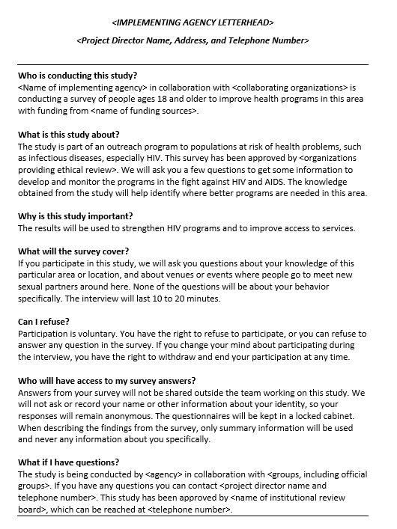
Fact sheet
Notes:
Note: Replace the image on this slide with the fact sheet adapted for this implementation of PLACE.
Now we will review the fact sheet.
Why do we give participants a Fact Sheet? To inform them about the study and the rights of participants. It also provides information to contact study personnel later if they have a question at a later time. This is part of treating a participant ethically.
You can see that there are several sections in this Fact Sheet that answer common questions about PLACE, for example: Who is conducting the study, what is the study about, why is this study important, what will the survey cover, can I refuse, who will have access to my survey answers, and what if I have questions?

Slide 27
Activity: Read the fact sheet
Read the fact sheet aloud.
Interviewers take turns reading a paragraph.
Feel free to ask questions about the content of the fact sheet.
Discussion: What are the key points in the fact sheet?
Notes:
Note: The purpose of this activity is for interviewers to hear the questions read aloud while they read along. Taking turns reading a question keeps the interviewers engaged, even though each interviewer may not have a turn due to the length of Form A.
Note: The trainer explains the purpose of each question and clarifies any doubts the interviewers have about their interpretation.
Let’s take turns reading aloud each paragraph of the fact sheet and discuss it as we go along. Feel free to ask questions so we can clarify any doubts. Interviewers should be able to explain and summarize the information on the fact sheet.
Note: The fact sheet has these key points:
The interview is part of an effort to improve health programs, specifically where to target HIV prevention programs.
We are not asking any questions about you or your life.
Participation is voluntary; you can refuse to answer any question or stop the interview at any time.
We will not record your name or any information that will make it possible to identify you later.

Slide 28
Putting It All Together
Notes:
Now that we have reviewed all the pieces of the community informant interview (tally sheet, fact sheet, and Form A), let’s put them together as one set of steps.

Slide 29
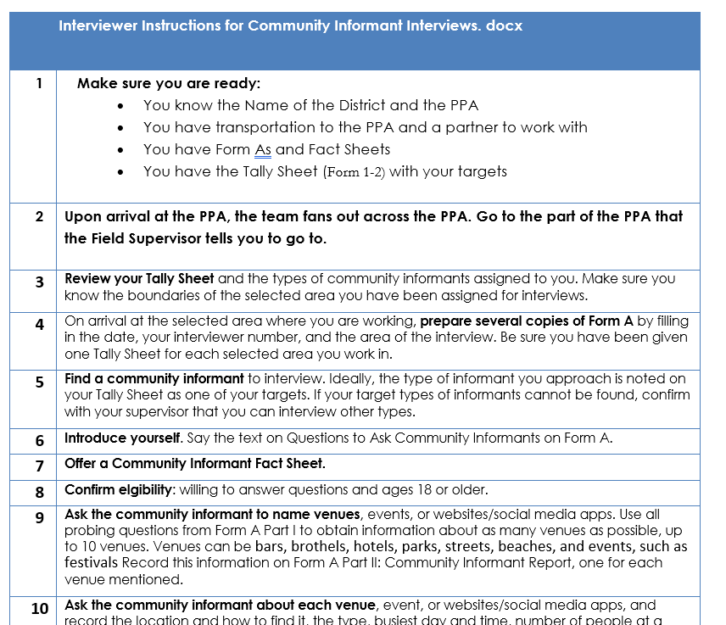
Steps
Step-by-step fieldwork instructions for community informant interviews
Notes:
Note: Replace this image of the fieldwork instructions with the version that will be used in this application of PLACE.
We will now review the steps for recruiting an informant with the fact sheet, conducting the interview and recording responses in Form A, and marking the type of informant on the tally sheet.
You will carry one copy of these instructions at all times.
Note: Interviewers take turns reading each step aloud.

Slide 30
Steps
Review the tally sheet for targeted types of informants.
Prepare several copies of Form A with your name/number, date, and location of the interview.
Find community informants.
Introduce yourself and describe the interview.
Offer the fact sheet.
Confirm eligibility (ages 18 or older, willing).
Ask the informant to name venues.
Complete Form A with information about each venue.
Thank the informant and record the types on the tally sheet.
Notes:
Note: Replace the Steps of Interviewer Instructions (Section 2.8 of the Fieldwork Implementation Guide) with the version that will be used in this application of PLACE.
So that you can see the steps more clearly, they have been abbreviated for this slide. Each step corresponds to a step on the sheet called Interviewer Instructions with the arrows that you should have in front of you.

Slide 31
Observe: Role-play
Interviewers observe recruitment of a community informant and interview using Form A.
Questions about the recruitment process?
Notes:
Note: This role play consists of two PLACE team members (e.g., Fieldwork Supervisors) conducting the recruitment and interview portion of Form A. The interviewers watch the role play but do not participate. This is meant to be a good example of an interviewer recruiting a community informant and carrying out the interview.
Note: After the role play, ask if the interviewers have any questions.

Slide 32
Activity: Practice
Interviewers form pairs.
One interviewer takes the role of a community informant while the interviewer recruits him/her and conducts the interview using Form A.
Reverse roles to give the other interviewer practice.
Change partners and begin the process again.
Each interviewer gets to practice with two different people.
Notes:
Note: Make sure the interviewers have several blank Form As to complete during practice.
Note: The purpose of this activity is to give the interviewers a chance to practice the recruitment of an informant, including pointing out the key points of the fact sheet. This is another chance to practice completing Form A.

Slide 33
Activity: Practice outside
Interviewers practice with two people in the community.
Go outside the training venue, but do not go far.
Return here immediately after two interviews.
Notes:
Note: Make sure the interviewers have several blank Form As to complete during practice.
Note: The purpose of this activity is to give the interviewers a chance to practice the entire process of recruiting and interviewing community informants in the immediate vicinity of the training venue with people unfamiliar with PLACE. Afterward, the group will discuss the process before going to the field for more practice and to look for community informants with knowledge of where people meet new sex partners or where people go who inject drugs. Supervisors and trainers accompany the interviewers outside.
Now we will practice with people in the community who are not familiar with PLACE. Each interviewer will recruit and interview two people. These people do not have to be informants of the types on the tally sheet.

Slide 34

Discussion
How was recruitment?
How were the interviews?
How many venues did each person name?
Questions about the steps?
Any other questions?
Notes:
Note: This provides an opportunity for interviewers to share their first experiences with community informant interviews. Trainers can help problem-solve, give tips, and address doubts.

Slide 35
Things to avoid (1)
Informant names a type of venue in general: “People go to bars”
    Not specific enough. Remember you will need to visit this place.
    Probe: “Can you tell me about one of the bars people go to?”
Informant says “I don’t know” to most questions
    They may really know but do not want to say or to think about it.
    Probe: “Remember, I just want to know what you think.”

Slide 36
Things to avoid (2)
Informant names few venues:
    A good informant will know many venues. You can record up to 10 venues from each informant. However, he/she may feel that it is enough after they’ve given you one or two venue names.
    Probe: “You are giving me very good information. Can you name more places.” Also make sure you have used all probing questions about key populations.

Slide 37
Interviewer role-play
Two interviewers volunteer to role-play recruitment and the interview.
Discuss strengths and weaknesses of the role- play.
Notes:
Note: This activity provides an opportunity for interviewers to critique the recruitment and interview process as carried out by a fellow interviewer. This can be done more than once with different pairs of interviewers.

Slide 38
Activity: Practice fieldwork
Go to the field.
Look for community informant types on the tally sheet: one taxi driver and four other types.
Complete the tally sheet and Form As.
Stay with your partner or within eyesight of your partner.
Notes:
Note: The purpose of this activity is to give the interviewers a chance to practice the entire process of recruiting and interviewing community informants in a setting that is like that of fieldwork. Supervisors and trainers accompany the interviewers to the field. Trainers can provide a tally sheet marked with five target types of informants. Make sure that the interviewers practice in an area where there is a sufficient number of people and activity.
Now we will practice in a setting that is similar to what you will experience during fieldwork. As in fieldwork, you and another interviewer work as partners so that you are always able to see one another. This is best practice for safety in the field.
After five interviews, contact the supervisor or trainer who is with you. Give him or her your completed forms.
Note: The supervisor or trainer who receives the completed forms should verify that the interviewer put his/her name on the Tally Sheet and Form As. The supervisors will review the forms and provide feedback to the interviewers.

Slide 39

Feedback
Supervisors and trainers review the completed Form As for quality with each interviewer.
Provide feedback to each interviewer.
Provide feedback to the group to share what was learned in reviewing the Form As.
Notes:
Note: One copy of “Form A Quality Checklist” is needed for each interviewer or trainer reviewing the completed forms. This is provided in the PLACE Tool Kit, online.
Now the supervisors and other trainers will review the forms you completed in the field. They will be looking to make sure that they can read what is written and that the form was filled in correctly. They will call you up one at a time to review your forms. Please wait patiently until this process is completed.
Note: For the review, a supervisor or trainer sits beside an interviewer and looks at the completed forms. Use “Form A Quality Checklist” to guide the review process. Feedback should include aspects of the work the interviewers need to improve and what was done well. After all forms are reviewed, tell the group what was observed in the completed forms. Pointing out the errors of some people (without naming names) can help others avoid the same errors.

Slide 40
PLACE fieldwork
Level 1: Community informant interviews
Level 2: Venue informant interviews and mapping
Level 3: Patron and worker interviews and HIV testing
Notes:
Remember that after we collect information about venues, we have to find them. We will begin Level 2 interviews, where we visit those venues. Keep this in mind when asking for the location and how to find venues: you will be using this information!

